Slide 1
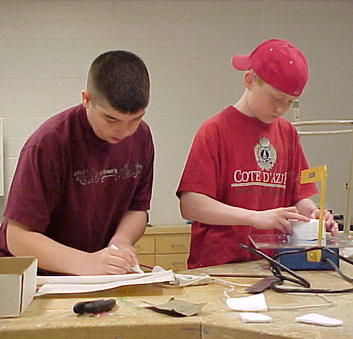
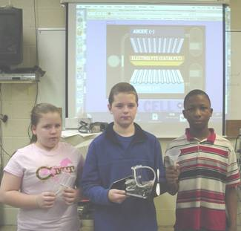
Foundations of Technology, Third Edition Technology, Engineering, and Design
Presentation 1.1.2
Notes:
TITLE SLIDE
On this slide, specialists should insert the logo of the agency where you are visiting. This is usually accessed from the website. When arranging the speaking engagement, ask for a tif or jpg of the logo.
POST TITLE SLIDE:
When arriving at the workshop site, this slide should be on the screen approximately 10 – 15 minutes before the workshop begins.
SPECIAL NOTE:
We are now the STEM Center for Teaching & Learning. Our focus is on teaching and learning.

Slide 2
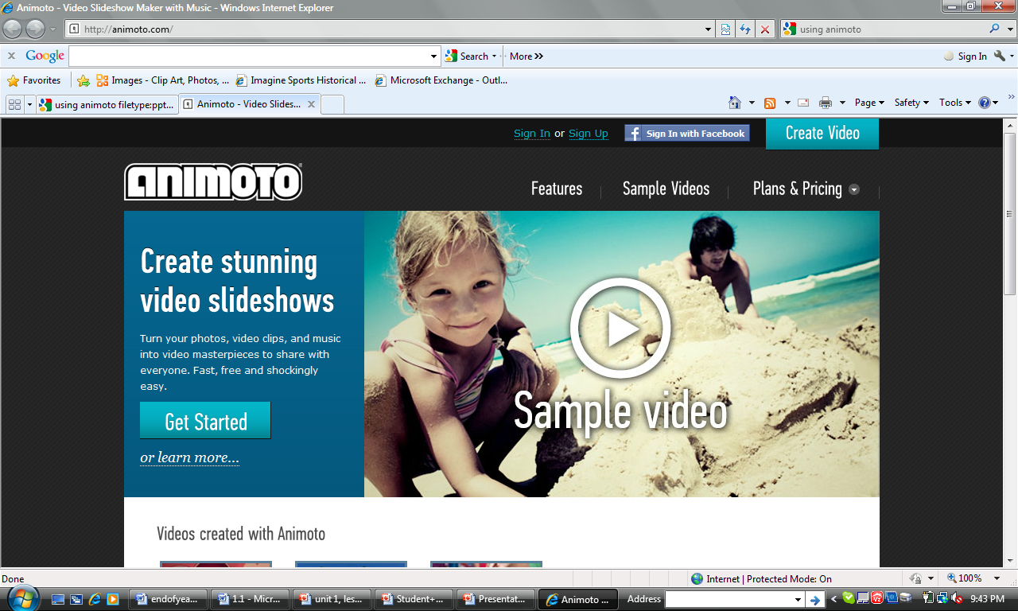
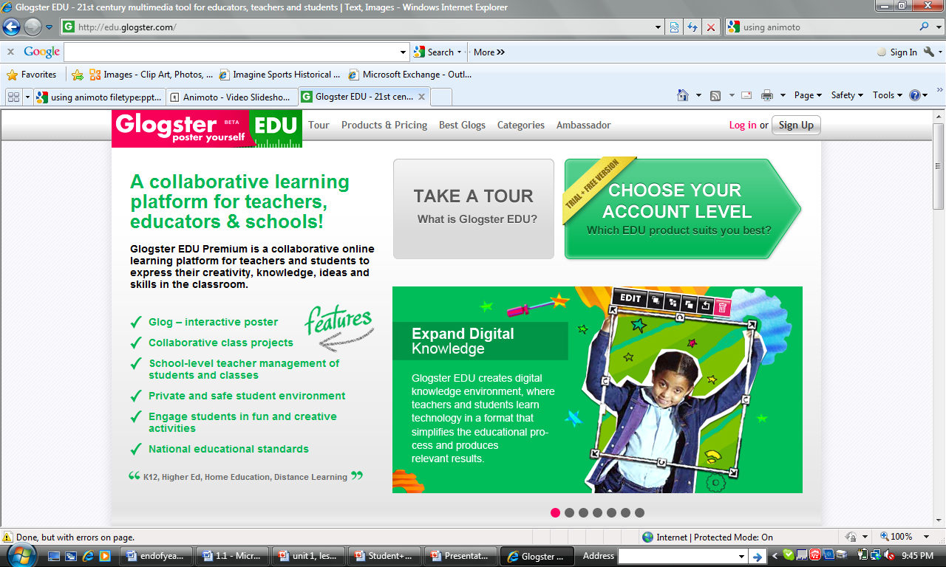
Properly Citing Sources
Notes:
For both sites, you will need to pre-register. For animoto, you will need to request an educator account, which may take up to two weeks for approval. For glogster, you can add your students.

Slide 3
What is Animoto?
Animoto is a web 2.0 tool that allows you to produce slideshow video presentations in minutes.
It has some advantages:
Limited technology skills are needed (need to know how to upload files).
The application edits your video.
Preset sounds and music are available in the gallery.
No two videos are the same.
Professional quality output.

Slide 4
Steps to use Animoto
1. Navigate to http://animoto.com/
2. Choose Sign Up

Slide 5
Steps to use Animoto
Choose “lite” (free).
Complete the registration information.

Slide 6
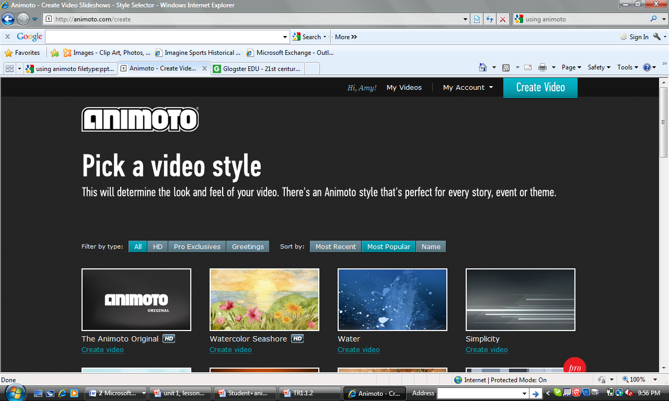
Steps to use Animoto
Choose “Get Started.”
Choose a video style, make sure you select the free version.

Slide 7
Steps to use Animoto
Choose “Upload” to add pictures from your research that you have saved to your computer.

Slide 8
Steps to use Animoto
8. Select the music tab to add music from the animoto library or upload your own.

Slide 9
Steps to use Animoto
9. Choose the finalize tab to set the settings for your final video, hit continue, and create video.

Slide 10
What is Glogster?
Glogster is a web 2.0 tool that allows students to design and create a virtual poster that can be saved online.
The student is able to upload images and embed video clips and audio clips that can be directly accessed through their virtual poster.

Slide 11
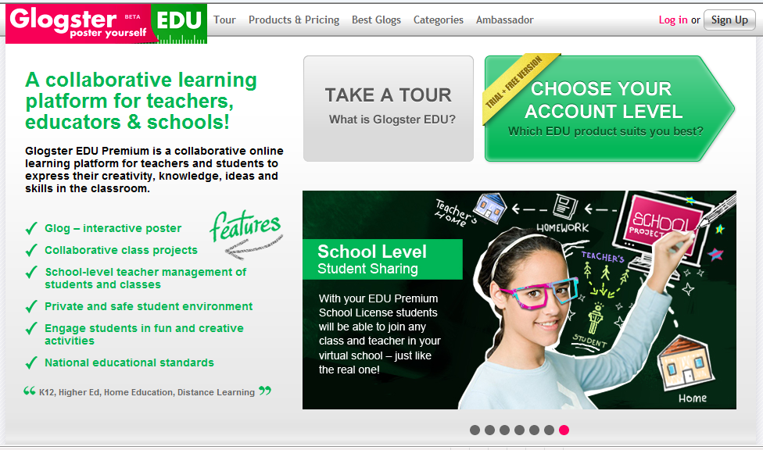
Steps to use Glogster
Navigate to: http://edu.glogster.com/
Choose Sign Up.
For Teachers

Slide 12
Steps to use Glogster
After registering and logging in, go to dashboard and select “add new students.”
Enter the number of students you need.
For Teachers

Slide 13
Steps to use Glogster
5. On the dashboard you will receive a message with the login information you will need to give your students.
For Teachers

Slide 14
Steps to use Glogster
1. Navigate to the link provided by your teacher and use the login and password info, if needed.

Slide 15
Steps to use Glogster
2. Choose “Create New Glog.”

Slide 16
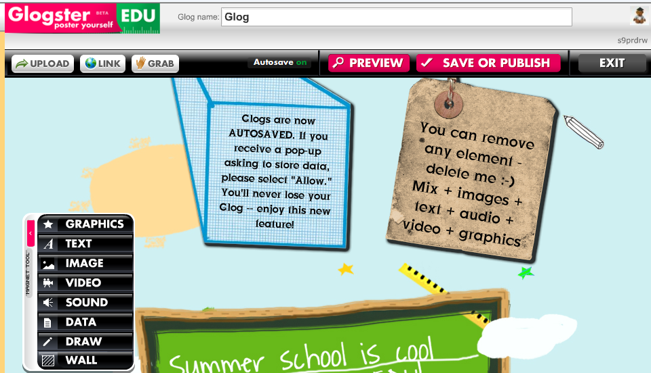
Steps to use Glogster
3. The default page can be edited. You can select the images on the page and delete them.

Slide 17
Steps to use Glogster
4. If you click on an image, an editing tool bar appears.

Slide 18
Steps to use Glogster
5. To add images, text, etc., use the magnet tool bar.

Slide 19
Steps to use Glogster
Upload a video
Publish your page and receive a URL
Exit to Dashboard
Link to a website
Preview your page
Access computer accessories such as webcam or microphone

Slide 20
Properly Citing Sources
Because you will be publishing to the web, you must be sure to adhere to copyright rules and terms of use.
MLA and APA are the most common formats for citing sources. APA is most appropriate for science and research fields. Therefore, we will use APA formatting for citations within this course.

Slide 21
Properly Citing Sources
There are several online tools to help you with properly citing sources using APA formatting.
NoodleTools: http://www.noodletools.com/ allows you to create an account and assists with formatting
Citationmachine.net: www.citationmachine.net allows you to select APA and the type of source
Citation Builder: http://www.lib.ncsu.edu/lobo2/citationbuilder/
allows you to enter the information for the source and converts to APA formatting
Notes:
[Do we have permission to link to these?]

Slide 22
Properly Citing Sources
Be sure to cite your sources on your Glogster page and place the proper citations at the end of your Animoto video.
Properly Citing Sources

Slide 23
References
Text Needed

