Slide 1
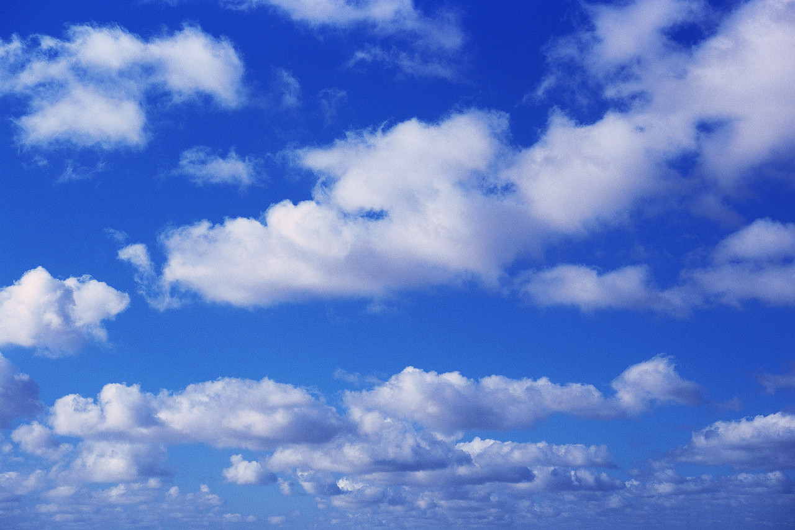
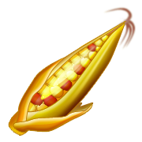
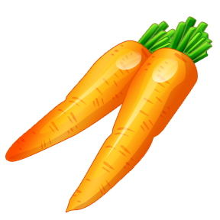
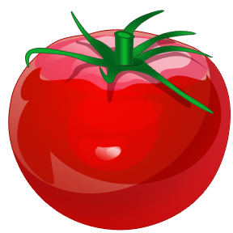
Agriculture and Transportation Systems
What is the
USDA?
What is Agriculture?
Learn more about the Ag industry
Transportation Systems in Agriculture
Home

Slide 2
The Unit Big Idea
The designed world is the product of a design process, which provides ways to turn resources - materials, tools and machines, people, information, energy, capital, and time - into products and services.
What is the
USDA?
What is Agriculture?
Learn more about the Ag industry
Transportation Systems in Agriculture
Home
Home

Slide 3
The Lesson Big Idea
Transportation plays a vital role in the operation of agricultural industries which includes a combination of businesses that use a wide array of products and systems to produce, process, and distribute food, fiber, fuel, chemical, and other useful products.
What is the
USDA?
What is Agriculture?
Learn more about the Ag industry
Transportation Systems in Agriculture
Home

Slide 4
What is Agriculture?
Agriculture includes a combination of businesses that use a wide array of products and systems to produce, process, and distribute food, fiber, fuel, chemical, and other useful products.
Similar to manufacturing, there are companies and farmers who specialize in primary harvesting (taking the natural element from the earth) and other companies and farmers who specialize in transforming the natural element into something for consumers and/or manufacturers of products.
What is the
USDA?
What is Agriculture?
Learn more about the Ag industry
Transportation Systems in Agriculture
Home
Home

Slide 5
What is the USDA?
The United States Department of Agriculture (USDA) oversees the rules and regulations related to agriculture and includes the Food Safety and Inspection Service Department which helps monitor the safety of food for the public.
What is the
USDA?
What is Agriculture?
Learn more about the Ag industry
Transportation Systems in Agriculture
Home
Click here for an American Agriculture History Timeline
Home

Slide 6
Learn more about the Ag industry
Navigate to: http://www.agclassroom.org/teen/teen1.htm and watch the intro to agriculture.
Look at several links on the site and summarize what you learned in your Engineering Design Journal.
What is the
USDA?
What is Agriculture?
Learn more about the Ag industry
Transportation Systems in Agriculture
Home
Home

Slide 7
Transportation Systems in Agriculture
Transportation plays a vital role in the operation of other technologies, such as manufacturing, construction, communication, health and safety, and agriculture.
Transportation systems include intermodal means of transportation, which means air, water, land and space vehicles.
In the case of agriculture, land is the most common mode of transportation utilized.
What is the
USDA?
What is Agriculture?
Learn more about the Ag industry
Transportation Systems in Agriculture
Home
Home
Click for examples of transportation systems in Agriculture

Slide 8
Examples of Transportation Systems in Ag
Transportation systems include the moving of goods and people.
Without transportation technologies, agriculture products would be incapable of moving from the natural occurring element location to consumers.
Grain elevators
Combines
Conveyers
What is the
USDA?
What is Agriculture?
Learn more about the Ag industry
Transportation Systems in Agriculture
Home
Home

Slide 9
Grain Elevator
Transportation system designed to move grain harvested into silos or storage bins and may or may not include stations for drying and cleaning of the grain prior to storage.
The first step at a grain elevator is the unloading of the incoming truck, railcar, or barge. A truck or railcar discharges its grain into a hopper, from which the grain is conveyed to the main part of the elevator. In the headhouse, the main part of the grain elevator, grain is lifted on one of the elevator legs and, at older facilities, is typically discharged onto the gallery belt, which conveys the grain to the storage bins.
A “tripper” diverts grain off the belt and into the desired bin. At more modern facilities, other modes of transfer include enclosed conveyors, direct spouting, augers, and screw conveyors. Grain is often cleaned, dried, and cooled for storage. Once in storage, grain may be transferred one or more times to different storage bins or may be emptied from a bin, treated or dried, and stored in the same or a different bin.
What is the
USDA?
What is Agriculture?
Learn more about the Ag industry
Transportation Systems in Agriculture
Home
Home

Slide 10
Combine
The crop is cut and directed into a rotating chamber with a series of beaters rotating in opposite directions. The crop is dislodged, falls to the bottom, and separated from debris by sieves. The grain is transferred to a hopped for transfer and the debris falls out the rear.
What is the
USDA?
What is Agriculture?
Learn more about the Ag industry
Transportation Systems in Agriculture
Home
Home

Slide 11
Conveyors
Conveyors are used in a variety of industries, but specifically utilized in agriculture to move products in and out of storage facilities.
A conveyor belt contains two or more pulleys, with a continuous loop of material - the belt - that rotates about them. One or both of the pulleys are powered, moving the belt and the material on the belt forward. The powered pulley is called the drive pulley while the unpowered pulley is called the idler.
What is the
USDA?
What is Agriculture?
Learn more about the Ag industry
Transportation Systems in Agriculture
Home
Home

